Slide 1

CLASSIFICATION ANALYSIS
PREDICTION OF BANK CHURN CUSTOMERS
Under the Guidance : Dr. Aakansha Gupta
By- Arjun Maurya

Slide 2

INTRODUCTION
One of the greatest challenges faced by service companies is to retain their customers .
Companies try to get some insights into customer data to identify the customers who are likely to leave.
Companies employ lots of techniques to retain their existing customers . The advantage of using these techniques is to determine what causes the churn and how it can be reduced.
OBJECTIVE
On the given data of a bank build a predictive model to determine the probability of the churn.

Slide 3
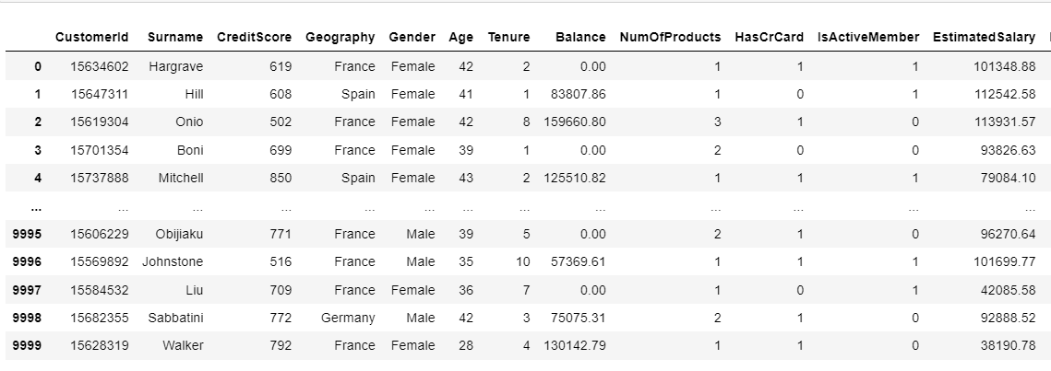
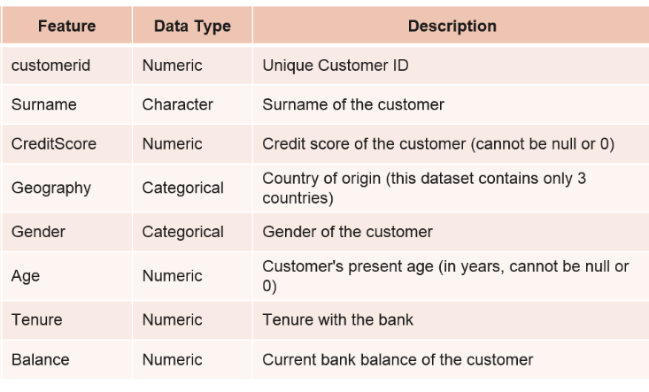
DATA COLLECTION
Importing libraries
Reading data to a Data Frame
10000 rows and 13 columns
Features Description

Slide 4
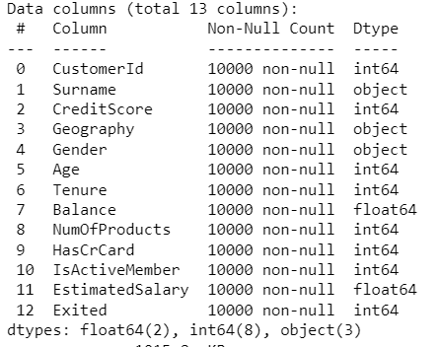
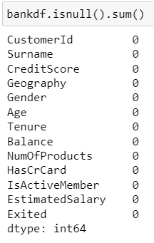
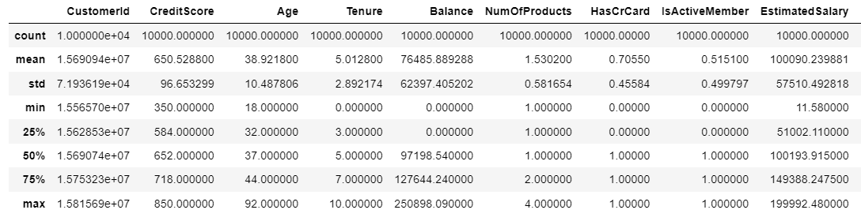
DATA EXPLORATION
Datatypes of the features
Handling missing values
Handling duplicate data
A statistical description of the features.

Slide 5
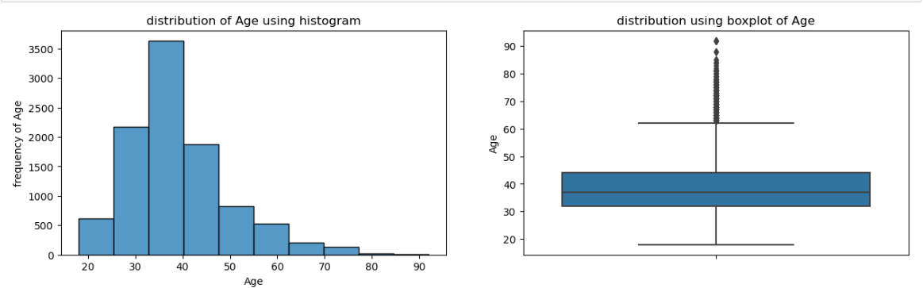
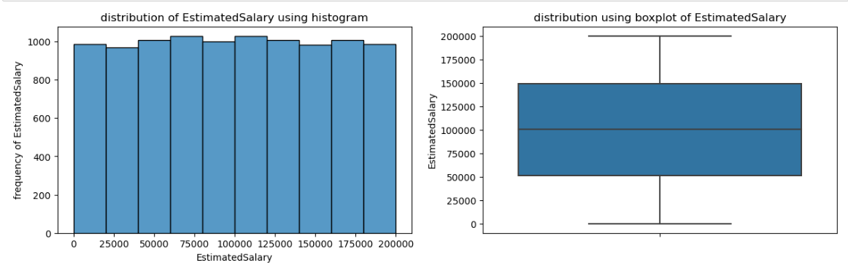
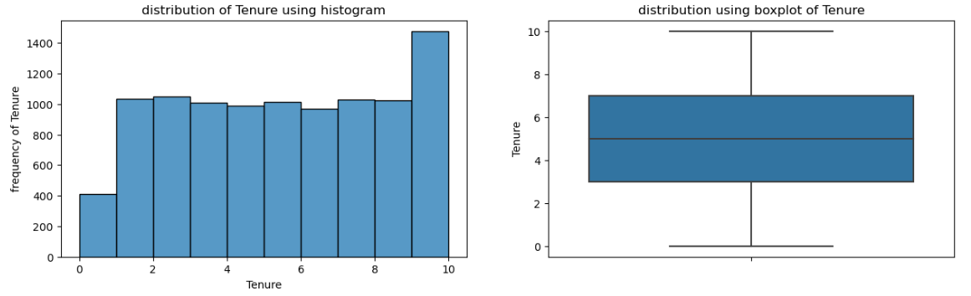
EXPLORATORY DATA ANALYSIS
Data for the Age column in normally with skewness.
Estimated Salary and Tenure are have a normal distribution.

Slide 6
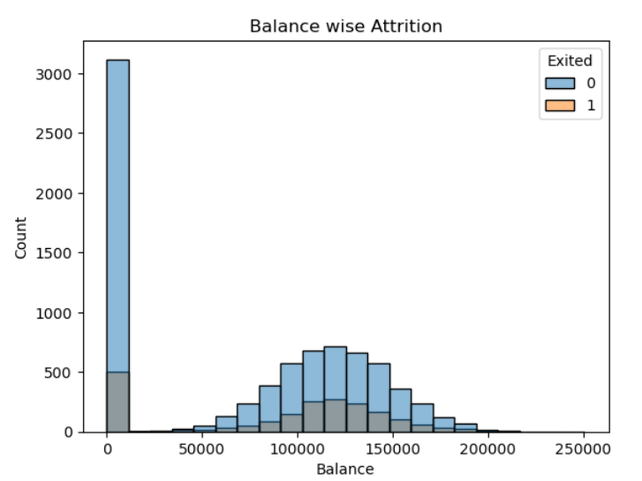
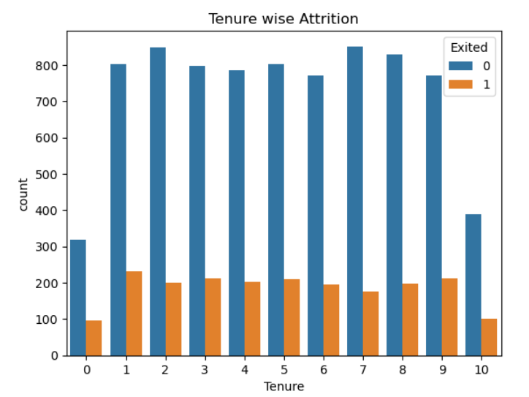
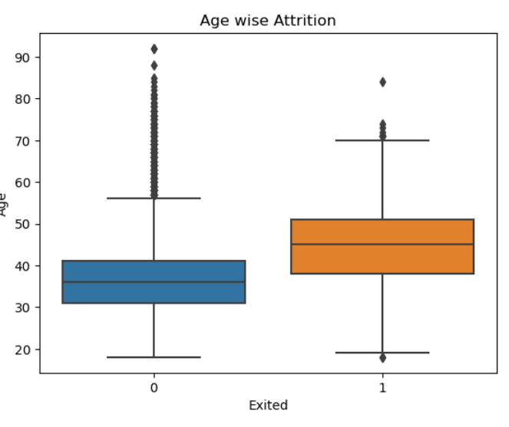
Most of the employees above age of 40 have attrited .
As the tenure increases attrition rate also increases.
Employees with no balance have high attrition to the ones who have average Balance.
Employees who are not active members have higher attrition to those who are active members.

Slide 7
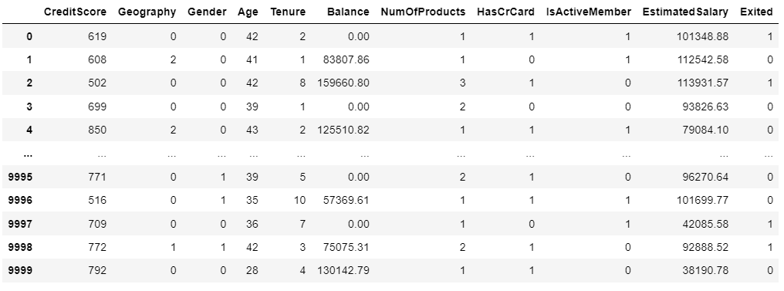
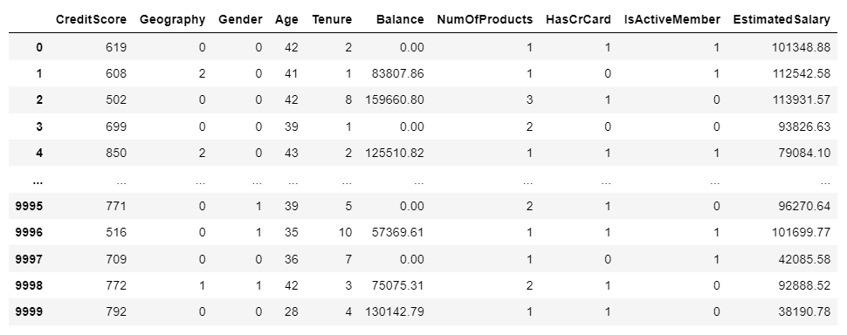
DATA PREPROCESSING
Label Encoding
Feature Scaling

Slide 8


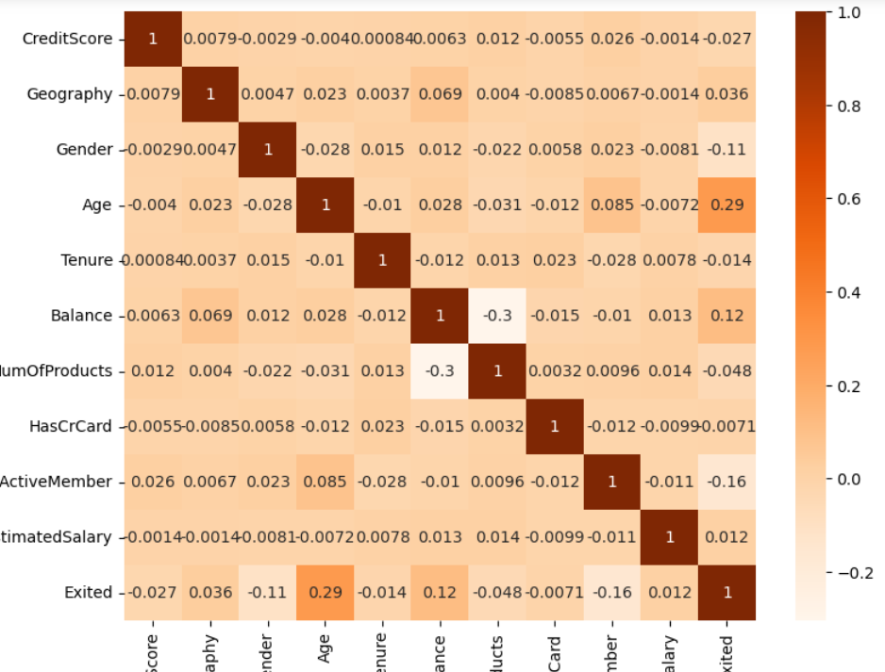
Splitting dataset for training and testing
Correlation

Slide 9

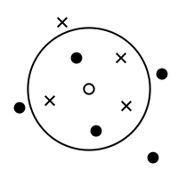

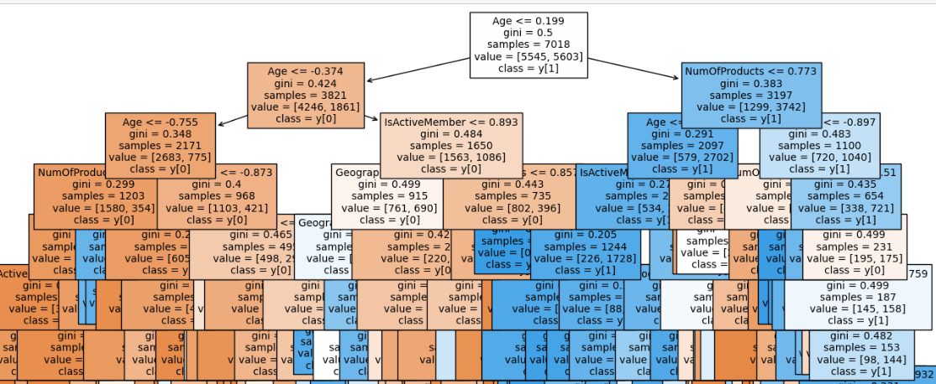
MACHINE LEARNING MODELS
The ML models used in this Classification Problem are:
Logistic Regression
Naïve Bayes
Decision Tree Classifier
Random Forest
KNN
Stacking

Slide 10
MODELS COMPARISON
PERFORMANCE EVALUATOR | LOGISTIC REGRESSION | NAÏVE BAYES | DECISION TREE | RANDOM FOREST | KNN | STACKING
TRAIN Accuracy | 0.7022 | 0.7413 | 0.8412 | 0.8648 | 0.771 | 0.9167
TEST Accuracy | 0.7028 | 0.7428 | 0.8166 | 0.8387 | 0.7588 | 0.8723
PRECISION | 0.6977 | 0.7357 | 0.8152 | 0.8226 | 0.7298 | 0.8405
F1 SCORE | 0.7023 | 0.7377 | 0.8163 | 0.8343 | 0.7686 | 0.8667
OVER ALL ACCURACY SCORE | 0.7053 | 0.7448 | 0.8166 | 0.8387 | 0.7588 | 0.866
Recall | 0.7062 | 0.7342 | 0.8090 | 0.8388 | 0.808 | 0.8805

Slide 11
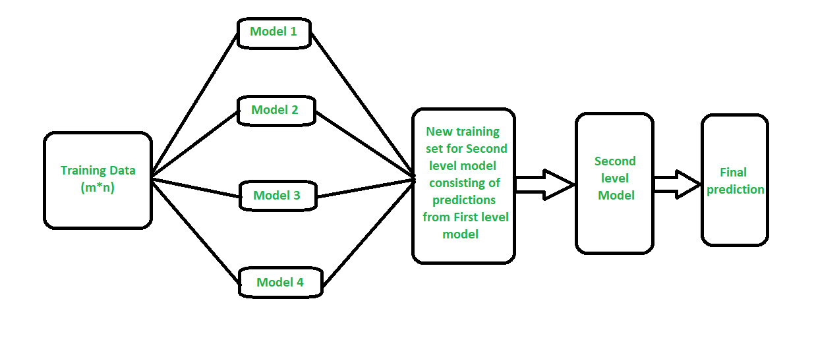
CONCLUSION
Logistic Regression showed the lowest performance.
Compared to all the good models Stacking Classifier has the highest performance .

Slide 12


